Slide 1
Steel Industry Energy Consumption Data Analysis and Mining
Kendrick Kee
Li Jin
Mohamed Abrar Ismail Mohamed Thahir

Slide 2
Introduction
Information gathered is from DAEWOO Steel Co. Ltd in Gwangyang, South Korea.
Data consists of energy consumption, output type and day/time of the observation.
Goals:
To visualize and discover insights from the dataset.
Develop 3 classification models.
Tune the models and evaluate the outcome.

Slide 3
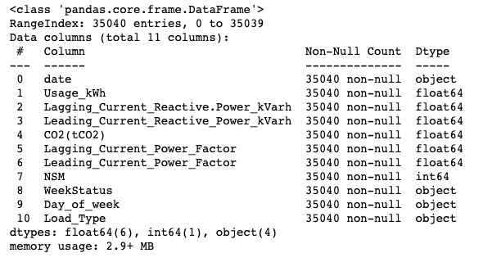
Data Cleaning and Pre - Processing
Company
Context
Context
Problem
Solution
All the columns in the dataframe are not numerically represented.
Object data types can’t be correlated to target class.
Load_Type is not numerically represented.
Encode all object data types.
Encode Load_Type to 0, 1, 2 to Light_Load, Medium_Load and Maximum_Load.

Slide 4
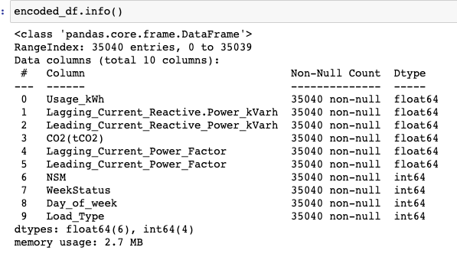
Results
Findings
All data types are now represented numerically.
Data column has been dropped as it all values are unique and can’t be correlated.

Slide 5
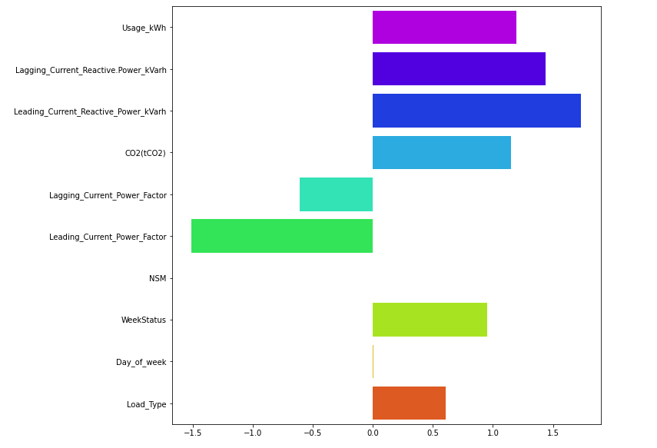
Visualisation
Findings
Features "Usage_kWh ","Lagging_Current_Reactive.Power_kVarh","Leading_Current_Reactive_Power_kVarh","CO2(tCO2)" are extremely right skewed with the scores of 1.197394, 1.437899, 1.734314, 1.149355 respectively.
The feature 'Leading_Current_Power_Factor' is extremely left skewed which scores -1.511984.

Slide 6
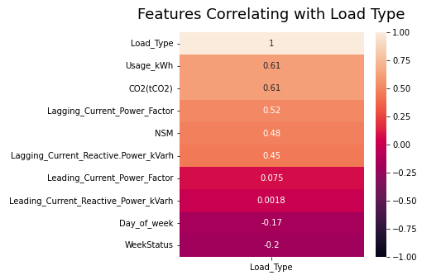
Visualisation
Findings
Findings
There seems to be positive correlations against target value 'Load_Type' with 'Usage_kWh','CO2(tCO2)',
'Lagging_Current_Power_Factor', 'Leading_Current_Power_Factor',
'NSM' with p value close to and greater than 0.5

Slide 7

Deep Dive
Analysis of interesting features

Slide 8
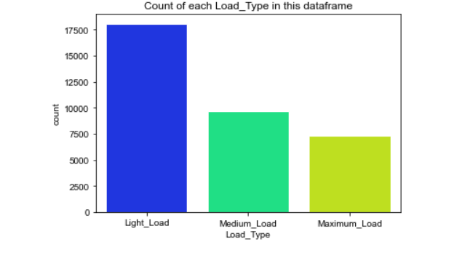
Visualisation
Findings
Light Load consists of more than half of the observations.
Medium and Maximum load are almost evenly distributed between each other.

Slide 9
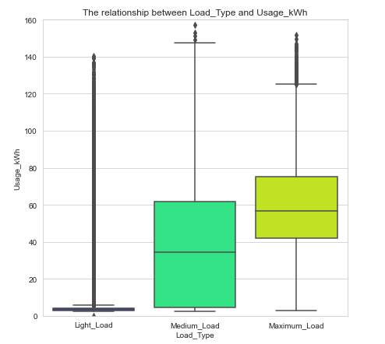
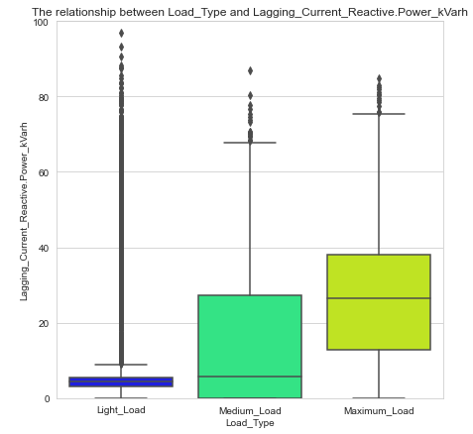
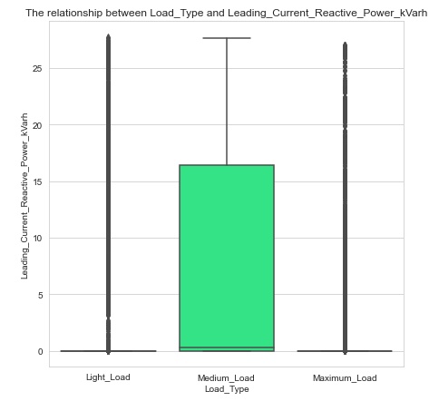
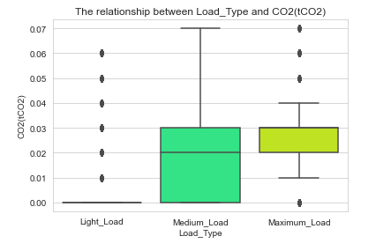
Visualisation - Box Plot
Findings
For half of the features, Light_Load is consistently observed with extreme amounts of outliers.
Leading_Current_Reactive_Power.. Feature has outliers for both Light and Maximum Loads.
CO2 data values are values between every 0.01.

Slide 10
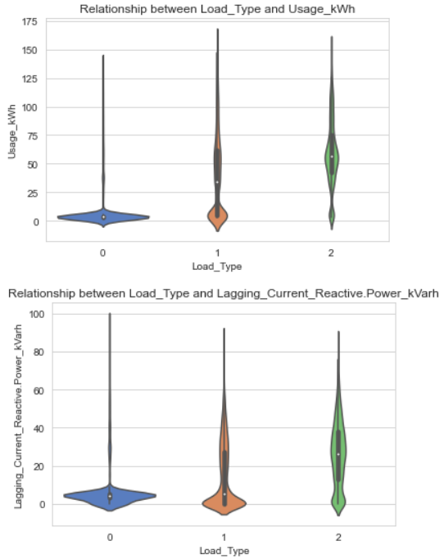
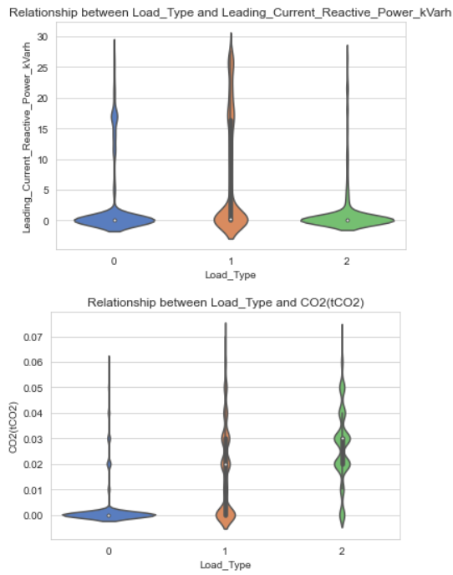
Visualisation - Violin Plot
Findings
Most of the load types consist with a lot of outliers
Leading_Current_Reactive_Power_kVarh seems to be skewed towards a 0 values for all Load_Types
Some of the Maximum_Load contains the highest median value in some plots

Slide 11
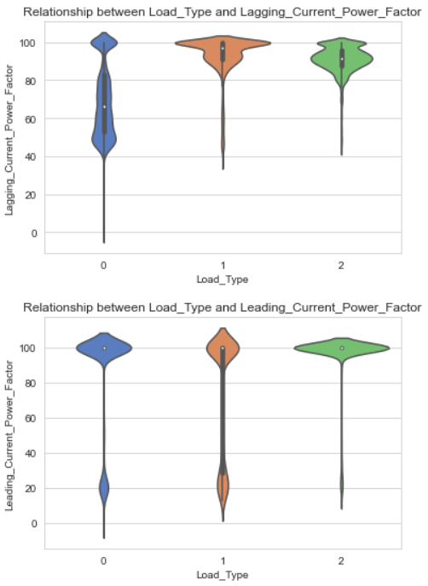
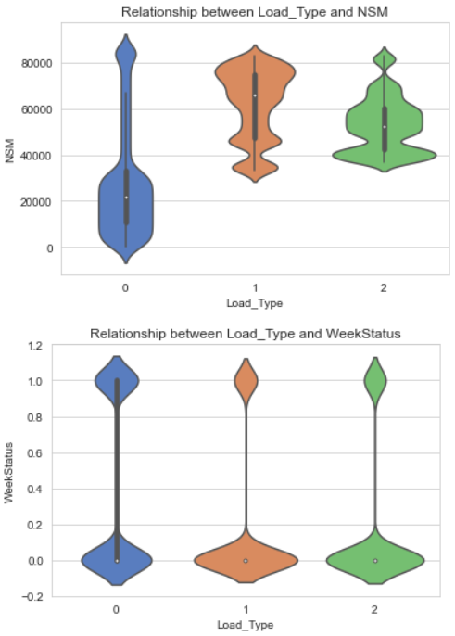
Visualisation - Violin Plot
Findings
Most of the load types consist with subpopulations from every plots
The value of NSM for light load is more cluster around the median value.
For different type of loads has same value of WeekStatus

Slide 12

Machine Learning
Development and Implementation of models

Slide 13
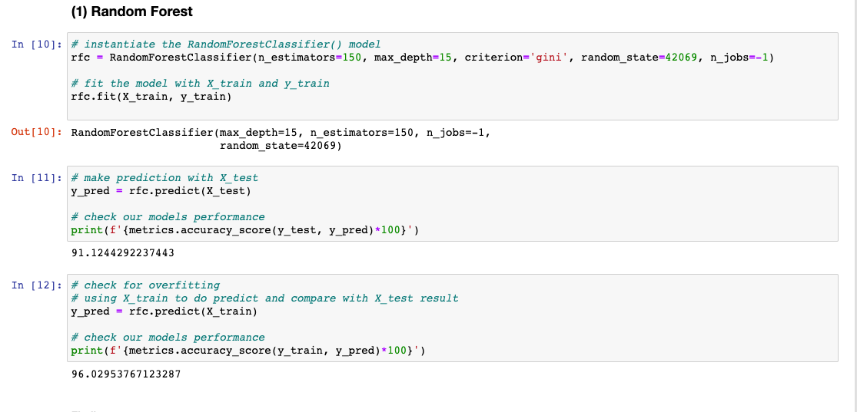
Random Forest Classifier
Findings
Based on the above result, we can see that with user defined parameters for the Random Forest Classifier which give us 91% accuracy for the testing set. In contrast, using the model on the testing set yielded a better result with an accuracy of 96%. We can therefore conclude that the model does not display signs of overfitting and has therefore obtained generalization of the dataset.

Slide 14
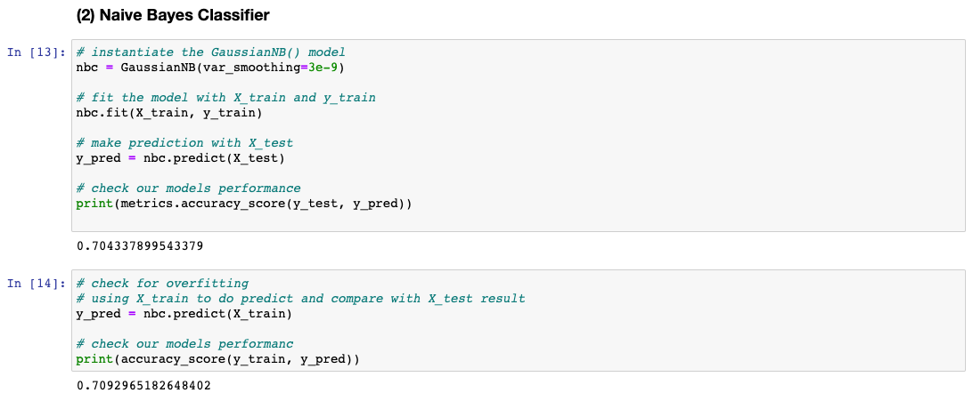
Naive Bayes Classifier
Findings
Setting the parameter for the GaussianNB as (var_smoothing=3e-9) offers a accuracy score of 70.4% for the training dataset. When using this model to predict testing dataset, it gives an accuracy of 70.9%. As the difference between both the training and testing dataset is 0.5% accuracy, we can conclude that the model does not show signs of overfitting and has displayed the ability to generalize.

Slide 15
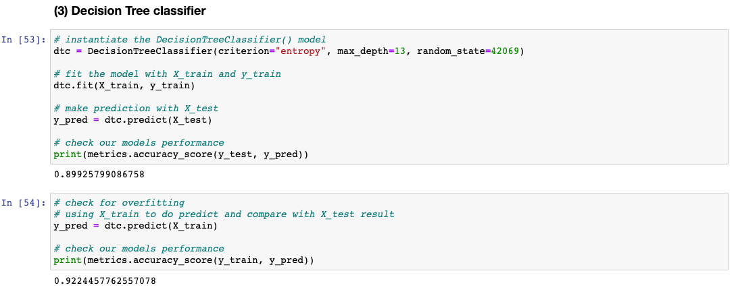
Decision Tree Classifier
Findings
For the parameters criterion="entropy", max_depth=13, random_state=42069 it produces an accuracy of 89% on the training dataset. In perspective, the performance of the model on the testing dataset is 92% which is 3% higher that it's performance on the training dataset. We can therefore conclude that the model shows no signs of overfitting.

Slide 16

Hyper parameter fine-tuning

Slide 17
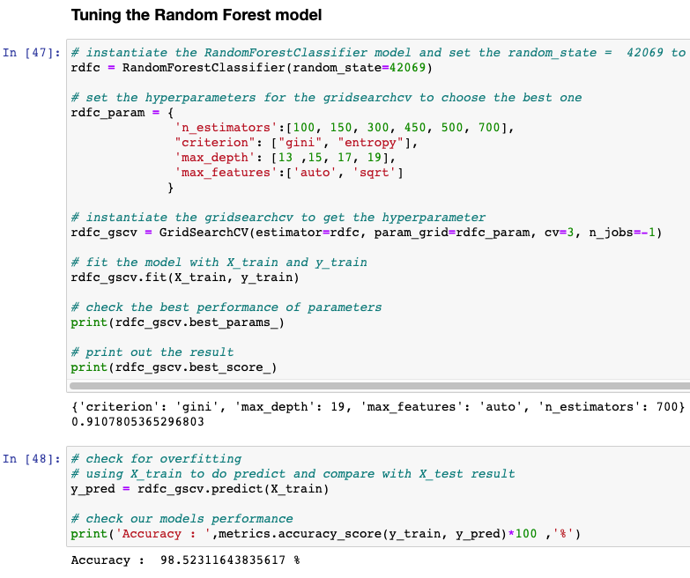
Random Forest Classifier
Findings
First, we can see that the accuracy becomes 91% compared to the prior 91% (without tuning) shows no significant improvement in the model even with optimised parameters.
Next, the tuning model do a prediction of the testing set data is 98% and when predict the training data which get a result of 91%. The model outperforms the training set accuracy by 7% which reinforces the fact that no overfitting has occurred and the model is able to generalise the information from the dataset.
We can observe that increasing depth also improves model performance in terms of accuracy as the pre-tuned model uses a max depth of 15 and the best depth determined from GridSearch which is 19 the difference in accuracy is 2.5% of which a deeper tree had the better outcome. We therefore can conclude that increasing depth will improve performance of the model if computational resources is not a limiting factor.
We can observe that increasing n_estimators from 150 to 700 also improves model performance by 2.5%, this is expected as increasing the number of trees will improve model accuracy at the cost of computational resources. Therefore, we can concluded that increasing n_estimators will improve model accuracy.
Findings

Slide 18
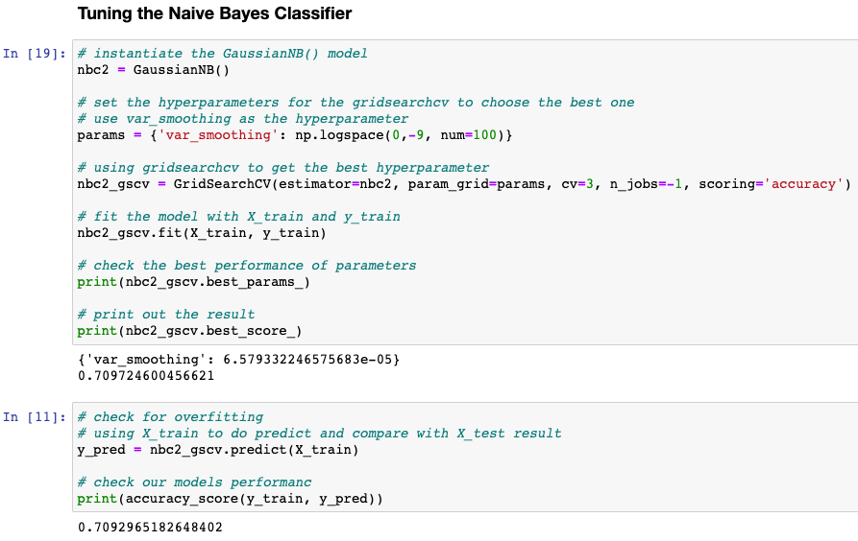
Naive Bayes Classifier
Findings
First, we can see that the accuracy becomes 70.9% which compared with the prior accuracy of 70.4% (without tuning) had a insignificant improvement of 0.5% in accuracy.
Next, the tuning model do a prediction of the testing set data is 70.9% and when predict the training data which get a result of 70.9%. As both accuracy of the models on both training and testing dataset are identical, we can conclude the there was no overfitting present.
For parameter 'var_smoothing', GridSearchCV evaluated that "6.579332246575683e-05 "as the best value for the model out of the nums parameters in np.logspace of 100. We therefore can conclude that the higher the var_smoothing, the better the overall performance of the model.
Findings

Slide 19
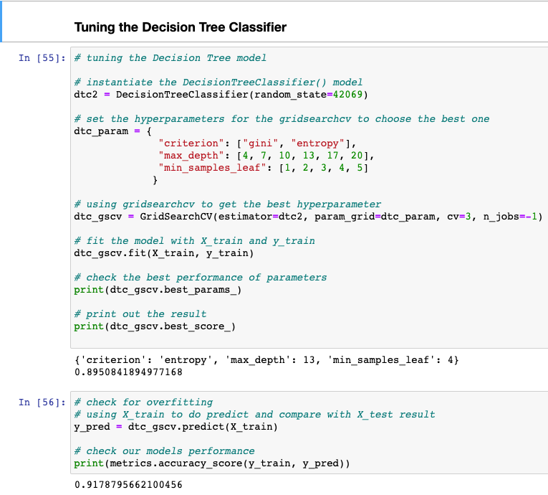
Decision Tree Classifier
Findings
First, we can see that the accuracy becomes 89.5% which compared to the prior accuracy of 89.9% (without tuning) has a insignificant reduction of 0.4% in model accuracy in the training dataset.
With regards to the accuracy of the model on the testing set data, 91.7% is achieved compared to 89.5% on the training dataset. As the difference in the accuracy is insignificant, we can conclude that the model does not show signs of overfitting pre and post tuning.
Between using gini or entropy as the split criteria, entropy split is presented to yield a better result by GridSearchCV.
We can also observe that using the range of parameters to tune the model played no significant role in its performance, parameters such as "criterion": ["gini", "entropy"],"max_depth": [4, 7, 10, 13, 17, 20],"min_samples_leaf": [1, 2, 3, 4, 5] ranges yielded only a 0.5% reduction in model accuracy. We can therefore conclude that pre tuned parameters of max_depth 13 and entropy as a split criteria to be the most optimal for the model.

Slide 20
Comparison of 3 Classification Models
We can observe that Random Forest model was able to outperform the latter boasting an accuracy of 98% post tuning with on the testing dataset which signals that its able to achieve the best performance of the other models without overfitting.
The 3 models were also not prone in overfitting or underfitting the dataset provided in this assignment. This could be due to the fact that my team only used significantly correlated features to train the model instead of using all features provided in the dataset which allowed for significant noise reduction and better performance.
Of all 3 models, Naive Bayes Model performed the worst with an accuracy of 70%~ pre and post tuning whilst showing no signs of overfitting. We therefore can assume that the selected model has reached it performance capacity for its use case in this current data set.

Slide 21

User Defined Transformation Function

Slide 22
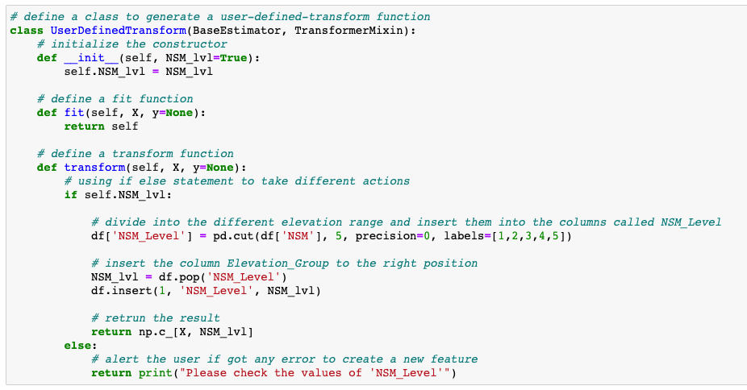
User Defined Transformation Function
Implementation
We generate a new feature called 'NSM_Level' since the feature 'NSM' appear across a wide range of values and may be noisy for the models to use as a predictive feature.
The new feature 'NSM_Level' has categorize the NSM values into 5 integers of 1, 2, 3, 4, 5. 5 values were picked as NSM as previously mentioned covers a large range of values hence to prevent any loss of information, more "partitions" will be created in its place.

Slide 23
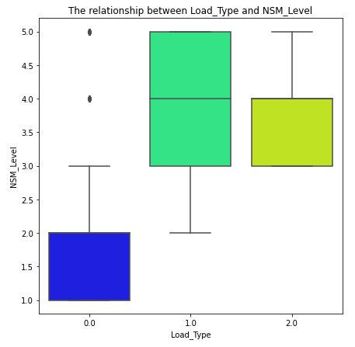
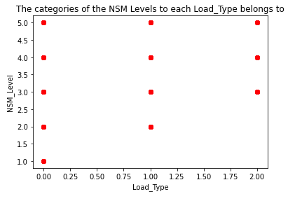
User Defined Transformation Function
Results
As we can observe, NSM_Level if 1-5 occurs for all Light_Loads while NSM_Level 1 is never present in Medium_Load, while Maximum_Load only has NSM_Load levels of 3 and above.
Therefore, we can attempt to use this in place of NSM to improve a model's performance as the values are more discrete.

Slide 24
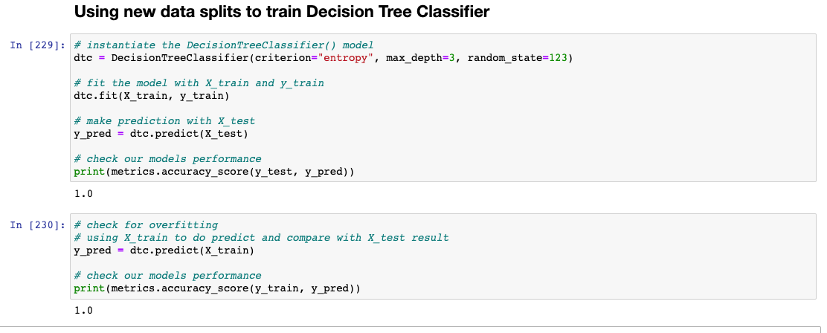
User Defined Transformation Function
Results
Training a Decision Tree model, we were able to reduce the DT max_depth to 3 and still be able to yield a 100% accuracy on both the training and testing datasets.
This ensures that the model was not overfitted and simply by transforming the NSM features into 5 bins/partitions, we were able to get the model accuracy from 70%~ to 100%.

Slide 25
THANK YOU

